Slide 1

cv
Analysis of Breast Cancer Detection using Ensemble Methods
Team Members
1. Shalini Singh (1DS19CS146)
2. Kota V Vishnu (1DS19CS723)
3. Reena Jasmine Edwin (1DS19CS738)
4. S Sai Brinda (1DS19CS741)
Under the Guidance of
Mrs Annapoorna B.R
Assistant Professor
Dept of Computer Science and Engineering
Department of Computer Science & Engineering, DSCE

Slide 2
cv
Introduction
Breast cancer is the leading cause of cancer deaths in women worldwide, with 2.26 million cases in 2020 according to WHO.
Breast cancer occurs when cells in the breast grow out of control and form tumours, which may be visible on an x-ray or palpable as a lump.
Breast cancer can spread to other parts of the body through the blood or lymph system, increasing the risk of cancer in those areas.
Early detection of breast cancer is important because it can increase the chances of successful treatment and survival.
Machine learning and Artificial Intelligence are being used more frequently as diagnostic tools for identifying breast cancer
Several tests, including clump thickness, cell size, and cell shape, are used to identify breast cancer, but it can still be difficult to get a definite result even for medical professionals
Department of Computer Science & Engineering, DSCE

Slide 3
cv
Introduction
The goal of this study is to investigate the use of various machine learning algorithms for early breast cancer diagnosis using the Wisconsin breast cancer dataset
To compare the performance of these algorithms using classification techniques such as Naïve Bayes, KNN, Random Forest, and SVM, and evaluate their accuracy using metrics such as recall, precision, F1 score, and accuracy percentage.
Department of Computer Science & Engineering, DSCE

Slide 4
cv
Challenges in the Current Work:
The existing techniques to detect Breast Cancer are not efficient enough to do early detection and predict the risk of cancer.
Using Logistic Regression is tough to obtain complex relationships using logistic regression.
Naïve Bayes relies on an often-faulty assumption of equally important and independent features which results in biased posterior probabilities.
KNN has a high estimated cost as the distance of each instance to all training tests is needed for a computer, and the value of K must be determined.
Random forest may not get good results for small data or low-dimensional data Random forest may not get good results for small data or low-dimensional data.
Department of Computer Science & Engineering, DSCE

Slide 5
cv
Objectives
Detecting the presence of Breast Cancer from the given dataset using different Machine Learning and Image processing techniques.
Calculating the level of risk of breast cancer based on a dataset.
Computing accuracy in terms of performance metrics such as recall, precision F1 score, and accuracy percentage.
Comparison of obtained results from different breast cancer detection techniques.
Concluding the performance of all techniques in different scenarios based on the analysis.
Department of Computer Science & Engineering, DSCE

Slide 6
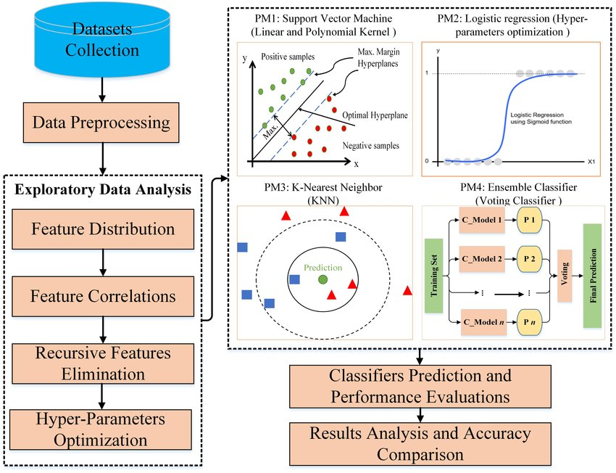
cv
Solution
Department of Computer Science & Engineering, DSCE

Slide 7
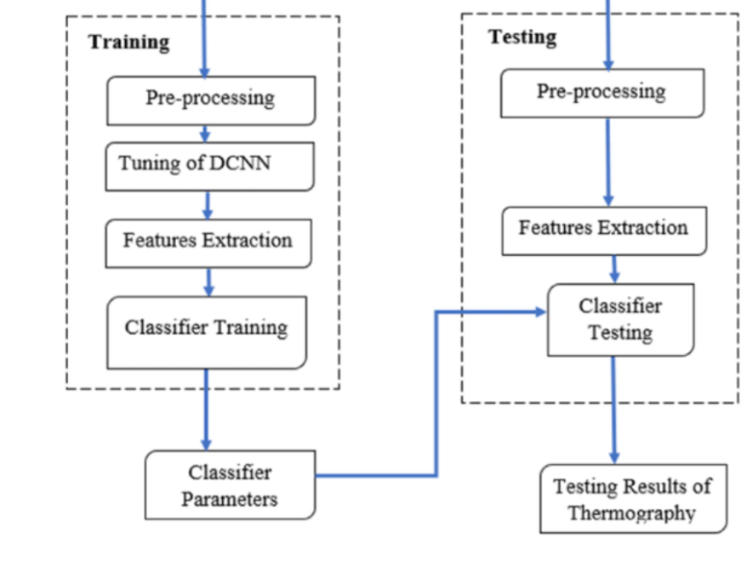
cv
Solution
Department of Computer Science & Engineering, DSCE

Slide 8
cv
Platform and Tools Used
Hardware: NVIDIA GTX
Programming Language: Python
Front End/Back End Tools:
Anaconda, Jupyter Notebook, Microsoft Power BI, Tableau, Github,Git
Dataset-
Breast Cancer Wisconsin (Diagnostic) Dataset
Source-Kaggle(https://www.Kaggle.com/datasets/uciml/breast-cancer-Wisconsin-data)
Features are Computed from fine needle aspirate of a breast mass. They describe the characteristic of cell nuclei present in the image.
Attribute Information-
1)ID NUMBER
2)DIAGNOSIS(M=malignant,B=benign)
Department of Computer Science & Engineering, DSCE

Slide 9
cv
Risks
The project might fail in detecting the presence of cancer which will increase the risk and severity of the disease as there is no medical treatment taken.
False predictions of a stage of cancer can lead to trauma, and anxiety and increase the chances of fatality.
Department of Computer Science & Engineering, DSCE

Slide 10
cv
Thank You
Department of Computer Science & Engineering, DSCE

